Slide 1
SWE-4805: Software Verification and Validation
Introduction
Md. Nazmul Haque
Lecturer, IUT
Department of Computer Science and Engineering
Islamic University of Technology
November 16, 2021

Slide 2
Contents
Contents
Motivation
Solution

Slide 3
Motivation
Floating-Point Error
On 4 June 1996, the maiden flight of the Ariane 5 launcher ended in a failure. Only about 40 seconds after initiation of the flight sequence, at an altitude of about 3700m, the launcher veered off its flight path, broke up and exploded.
Specification Flaw

Slide 4
Motivation
Year Ambiguity
Specification: In 1992, Mary received an invitation to attend a kindergarten in Winona, Minnesota, along with others born in '88.
Truth: Mary was 104 years old at the time.
Specification Flaw

Slide 5
Motivation
Specification if you can’t say it, you can’t do it
You have to know what your product is before you can say if it has a bug.
A specification defines the product being created and includes:
Functional requirements that describes the features the product will support. E.g., on a word processor
Save, print, check spelling, change font, …
Non-functional requirements are constraints on the product. E.g,
Security, reliability, user-friendliness, platform, …

Slide 6

Motivation
Air Traffic Control System Failure
In September 2004, air traffic controllers in the Los Angeles area lost voice contact with 800 planes allowing 10 to fly too close together, after a radio system shut down.
Design Flaw

Slide 7
Motivation
Bug in Space Code
Project Mercury’s FORTRAN code had the following fault:
DO I=1.10 instead of ... DO I=1,10
The fault was discovered in an analysis of why the software did not seem to generate results that were sufficiently accurate.
The erroneous 1.10 would cause the loop to be executed exactly once!

Slide 8
Motivation
Military Aviation Problems
An F-18 crashed because of a missing exception condition:
if ... then ... without the else clause that was thought could not possibly arise.
In simulation, an F-16 program bug caused the virtual plane to flip over whenever it crossed the equator, as a result of a missing minus sign to indicate south latitude.

Slide 9
Motivation
A Software Bug Occurs When
The software does not do something that the specification says it should do.
The software does something that the specification says it should not do.
The software does something that the specification does not mention.
The software does not do something that the product specification does not mention but should.
The software is difficult to understand, hard to use, slow …

Slide 10
Motivation
Percentage of Bug in SDLC Stages
Specification (~= 55%)
Design (~= 25%)
Code (~= 15%)
Other (~= 5%)

Slide 11
Motivation
Relative cost of bugs “bugs found later cost more to fix”
Cost to fix a bug increases exponentially (10x)
i.e., it increases tenfold as time increases.
E.g., a bug found during specification costs $1 to fix.
… if found in design cost is $10
… if found in code cost is $100
… if found in released software cost is $1000

Slide 12
Motivation
Sources of Problems
Requirements Definition: Erroneous, incomplete, inconsistent requirements.
Design: Fundamental design flaws in the software.
Implementation: Mistakes in chip fabrication, wiring, programming faults, malicious code.
Support Systems: Poor programming languages, faulty compilers and debuggers, misleading development tools.
Inadequate Testing of Software: Incomplete testing, poor verification, mistakes in debugging.
Evolution: Sloppy redevelopment or maintenance, introduction of new flaws in attempts to fix old flaws, incremental escalation to inordinate complexity.

Slide 13
Motivation
Adverse Effects of Faulty Software
Communications: Loss or corruption of communication media, non-delivery of data.
Space Applications: Lost lives, launch delays.
Defense and Warfare: Misidentification of friend or foe.
Transportation: Deaths, delays, sudden acceleration, inability to brake.
Safety-critical Applications: Death, injuries.
Electric Power: Death, injuries, power outages, long-term health hazards (radiation).

Slide 14
Motivation
Adverse Effects of Faulty Software
Money Management: Fraud, violation of privacy, shutdown of stock exchanges and banks, negative interest rates.
Control of Elections: Wrong results (intentional or non-intentional).
Control of Jails: Technology-aided escape attempts and successes, accidental release of inmates, failures in software controlled locks.
Law Enforcement: False arrests and imprisonments.

Slide 15
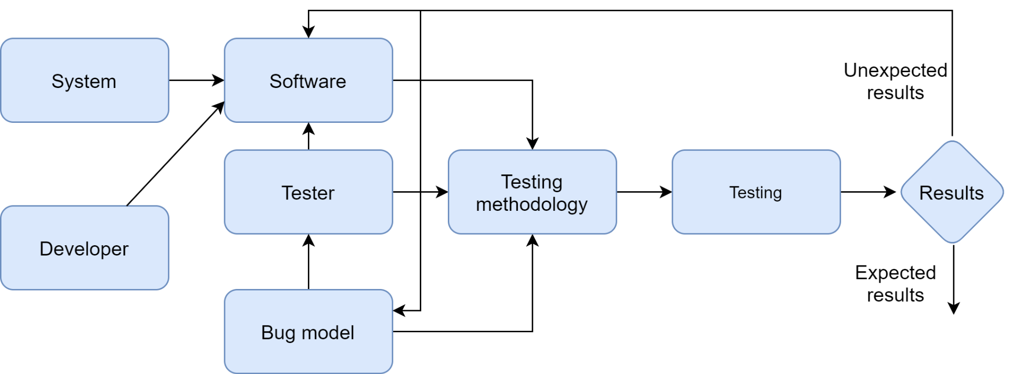
Solution
Software Testing Model

Slide 16
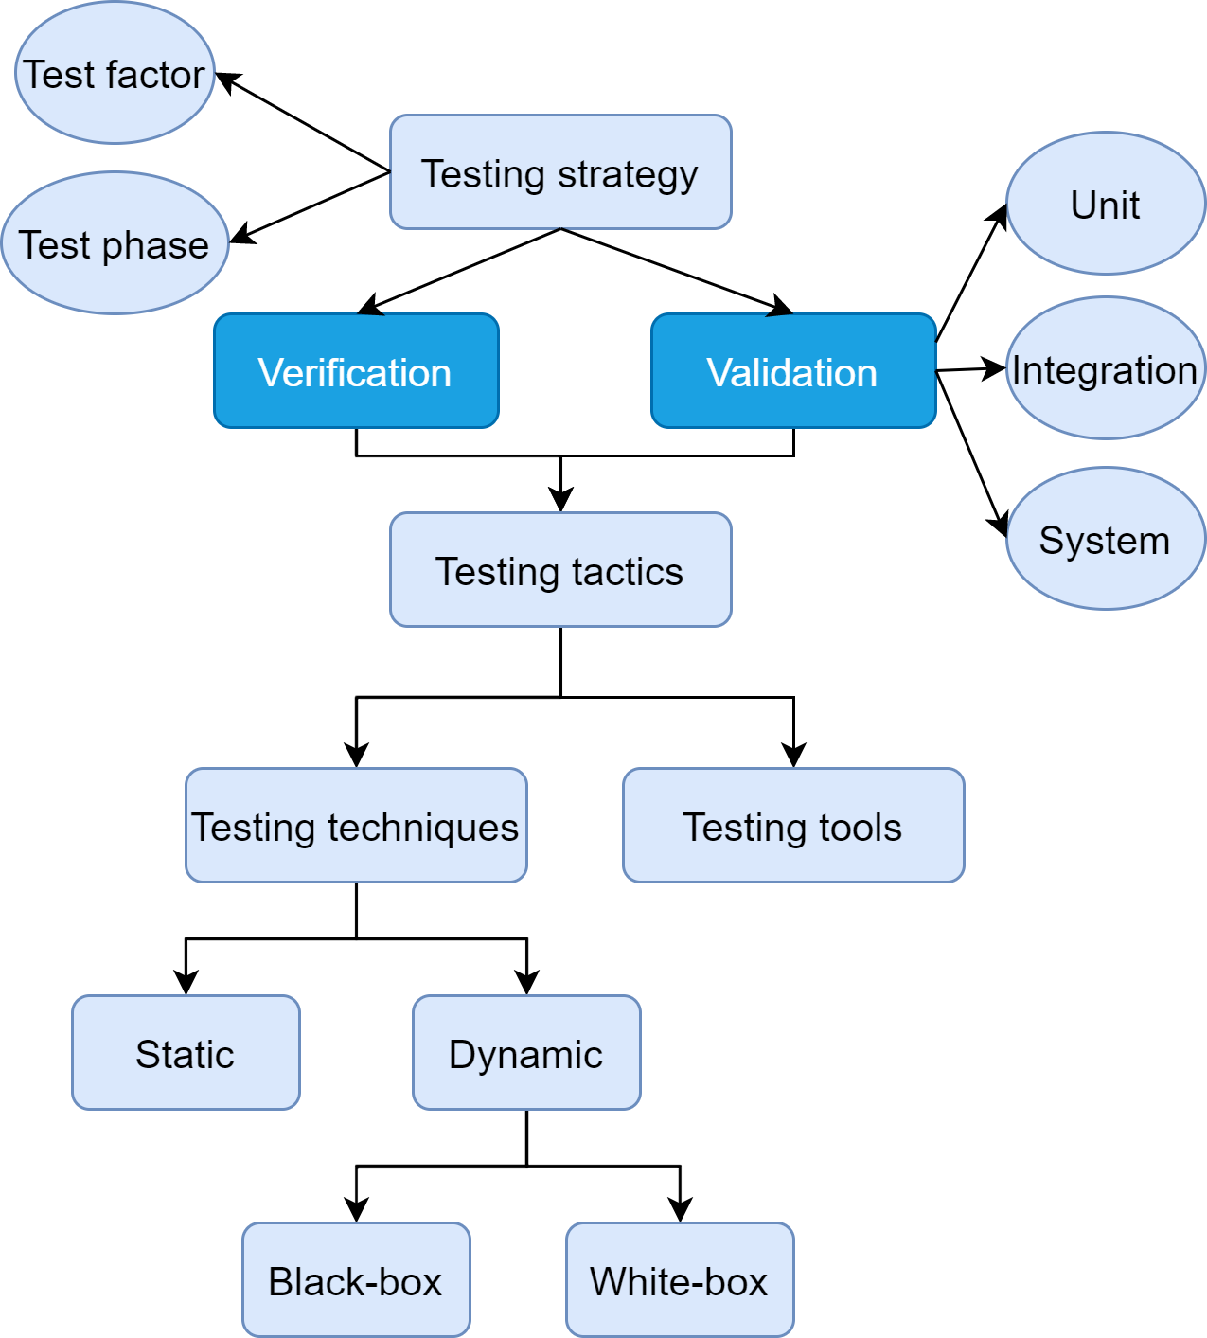
Solution
Software Testing Methodology

Slide 17
ANY QUESTION ?
THANK YOU !

Slide 18
Acknowledgements
Acknowledgements
[1] Marcus S. Fisher, Software Verification and Validation: An Engineering and Scientific Approach, Springer, 2007 edition, 2006.
[2] Chauhan, Naresh. Software Testing: Principles and Practices. Oxford university press, 2010.

